Slide 1
Data Processing
Module 4

Slide 2
Coverage
CDAP Concepts & Capabilities
Data Ingestion & Exploration
Understanding Datasets
Batch and Real-time Pipelines
Action and Triggers
Preferences and Runtime configurations
Scheduling & Sequencing Pipelines
Namespaces
Writing custom plugins
Metadata, DataSet lineage and usage metrics
Metrics and logging
SampleApp Pipeline Walkthrough

Slide 3
Introduction to CDAP
An open-source data processing framework with UI support
Easy to build data processing pipelines from UI
Easy to integrate with external systems using datasets (internal and external)
Explore and build locally and deploy remotely
Build once and deploy
Rich Rest, CLI and UI capabilities
Supports Metadata and Lineage
Quick Application/workflow development using easy to use CDAP APIs
Notes:
> CDAP programming interface provides 2types of abstractions - data and application > > Creating namespace in cdap
Hdfs: hdfs dfs -mkdir /testuser2
Hive: CREATE DATABASE testuser2HiveDB;
HBase: create_namespace 'testuser2HbaseNS'

Slide 4
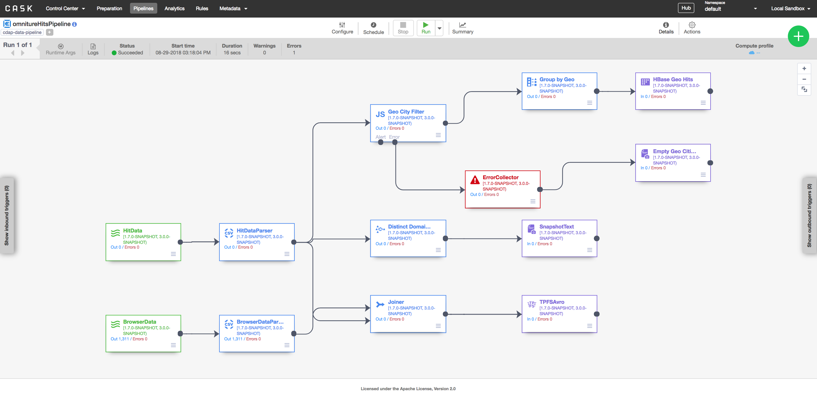
Sample Pipeline Example: Screenshot

Slide 5
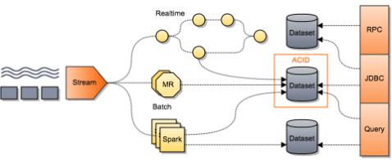
Anatomy of Big Data Applications
Notes:
Streams for Ingestion abstraction across realtime or batch.
Datasets are also abstractions. And serving layer through CDAP Services.

Slide 6
Architecture - CDAP Components
CDAP Master:
Service for managing runtime, lifecycle and resources of CDAP applications and services
CDAP Router:
Service supporting HTTP RESTful endpoints for CDAP
CDAP Kafka:
Metrics and logging transport service, using an embedded version of Kafka
CDAP UI:
User interface for managing CDAP applications
CDAP Authentication Server (Optional):
Performs client authentication for CDAP
CDAP CLI (optional):
User interface for interacting with CDAP from within a shell
Notes:
The Router is the only public access point into CDAP for external clients. It forwards client requests to the appropriate system service or application. In a secure setup, the router also performs authentication; it is then complemented by an authentication service that allows clients to obtain access tokens for CDAP.
System Services provide vital platform features such datasets, transactions, service discovery logging, and metrics collection. System services run in application containers.
Application Containers provide abstraction and isolation for execution of application code (and, as a special case, system services). Application containers scale linearly and elastically with the underlying infrastructure.

Slide 7
Building Stock Selection Pipeline: High Level

Slide 8
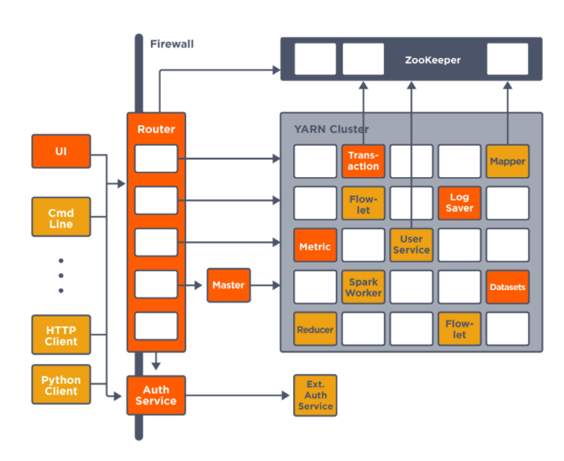
Architecture
A High Level Look
Notes:
CDAP consists chiefly of these components:
The Router is the only public access point into CDAP for external clients. It forwards client requests to the appropriate system service or application. In a secure setup, the router also performs authentication; it is then complemented by an authentication service that allows clients to obtain access tokens for CDAP.
The Master controls and manages all services and applications.
System Services provide vital platform features such datasets, transactions, service discovery logging, and metrics collection. System services run in application containers.
Application Containers provide abstraction and isolation for execution of application code (and, as a special case, system services). Application containers scale linearly and elastically with the underlying infrastructure.

Slide 9
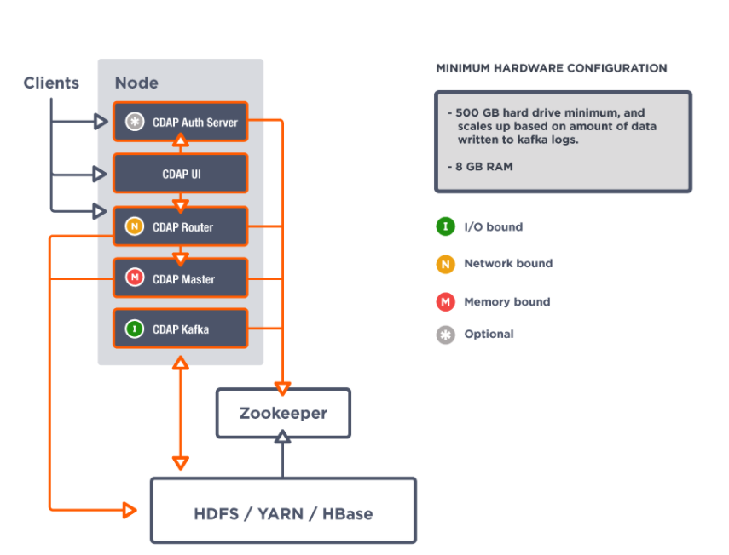
Architecture
CDAP Standalone Deployment

Slide 10
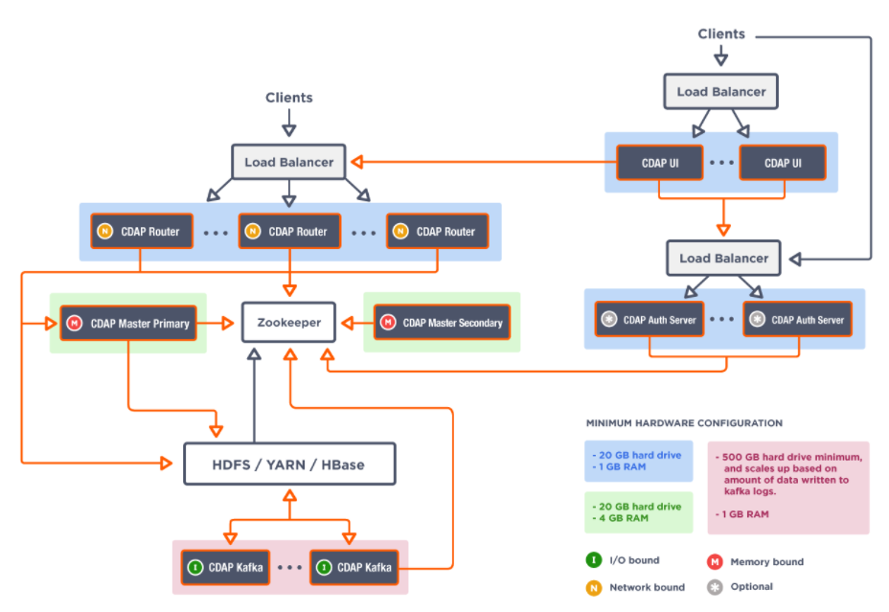
Architecture
CDAP High Availability and Highly Scalable Deployment
Notes:
Authentication in rest calls to be checked.

Slide 11
CDAP Modes and Components
Distributed CDAP
Production/Staging
Standalone CDAP
Testing and Development
In-Memory CDAP
unit testing and continuous integration
Notes:
Distributed:
A production, staging, and QA mode; runs in a distributed environment
Currently uses Apache HBase and HDFS as the underlying storage technology
Uses Apache Yarn Containers as the processing abstraction (via Apache Twill)

Slide 12
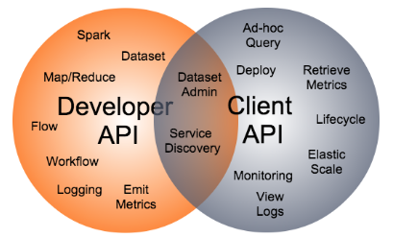
CDAP Programming Interfaces
Developer Interface
Client Interface

Slide 13
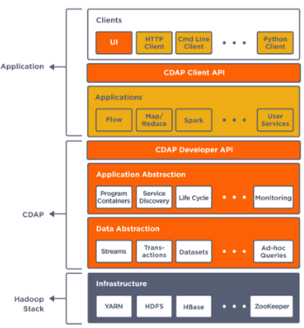
CDAP Abstractions

Slide 14
QuickStart with Hub (Marketplace)
This one is a Demo.
Notes:
https://docs.cask.co/cdap/3.6.0/en/developers-manual/getting-started/quick-start.html#quick-start

Slide 15
CDAP Applications
Applications are composed of Programs, Services and Schedules.
Programs include Flows, MapReduce programs, Workflows, Spark programs, and Workers are used to process data. Services are used to serve data.
Data abstractions include Streams and Datasets.

Slide 16
Streams
Ordered, time-partitioned sequences of data
Usable for real-time collection and consumption of data.
Data Written to a stream can be consumed in real-time by Flows or in batch by MapReduce programs.

Slide 17
DataSets
Store and retrieve data.
Table
FileSets
Partitioned FileSets
TimePartitioned FileSets
…
System and Custom DataSets
Cube DataSet

Slide 18
Table
The Table API provides basic methods to perform read, write and delete operations, plus special scan, atomic increment and compare-and-swap operations.
No Fixed Schema, Sparse Data
Common in Real-time programs (Random Access)
Notes:
The core datasets of CDAP are Tables and FileSets:
Unlike relational database systems, CDAP Tables are not organized into rows with a fixed schema. They are optimized for efficient storage of semi-structured data, data with unknown or variable schema, or sparse data.
CDAP FileSets provide an abstraction over the raw file system, and associate properties such as the format or the schema with the files they contain. In addition, partitioned file sets allow addressing files by their partition meta data, removing the need for applications to be aware of actual file system locations.
Other datasets are built on top of tables and file sets. A dataset can implement specific semantics around a core dataset, such as a key/value Table or a counter Table. A dataset can also combine multiple datasets to create a complex data pattern. For example, an indexed Table can be implemented by using one Table for the data and a second Table for the index of that data.
A number of useful datasets—we refer to them as system datasets—are included with CDAP, including key/value tables, indexed tables and time series. You can implement your own data patterns as custom datasets, on top of any combination of core and system datasets.

Slide 19
FileSets
Abstraction over underlying file system;
Represents collection of files.
Associate format or Schema with files.
Optimized for sequential read and write. (HDFS File)
Partitioned FileSets allow files by their partition metadata.

Slide 20
Views
Read-only source from where data can be read.
Similar to a stream or dataset.
Views and CDAP Explore
Notes:
https://docs.cask.co/cdap/3.6.0/en/developers-manual/building-blocks/views.html
iews are a read-only source from where data can be read. They are similar to a stream or dataset. They provide a way to read from the same source using different schemas.
Without views, you would need to begin your data application by deciding how you wanted to use your data, create appropriate schemas, and then fit the data to those schemas.
Now, with views, you start with your data and add schema to fit your needs. If you decide to add a column to your schema, CDAP simply reconfigures the code that reads your data instead of rewriting all of it. Changing the way you use your data no longer changes the way you write it. This flexible approach is much better when you have lots of data that you can use in many different ways, or when you are still trying to understand the data you have.
For example:
An admin wants to expose different parts of the same data to different stakeholders;
A user wants to only consume a small part of a data stream for performance reasons, to avoid parsing entire rows of data; or
A user has loaded in data without yet knowing or understanding how it will or can be used, and now wants to look at it in different ways.

Slide 21
Application Abstractions (Building Blocks)
Flows and Flowlets
Mapreduce/Spark Programs
Plugins
Schedules
Services
Workers
Workflows

Slide 22
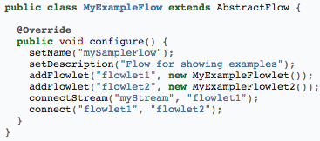
Streaming: Flows and Flowlets
User-implemented real-time stream processors.
Comprised of 1 or more flowlets that are wired into a DAG.

Slide 23
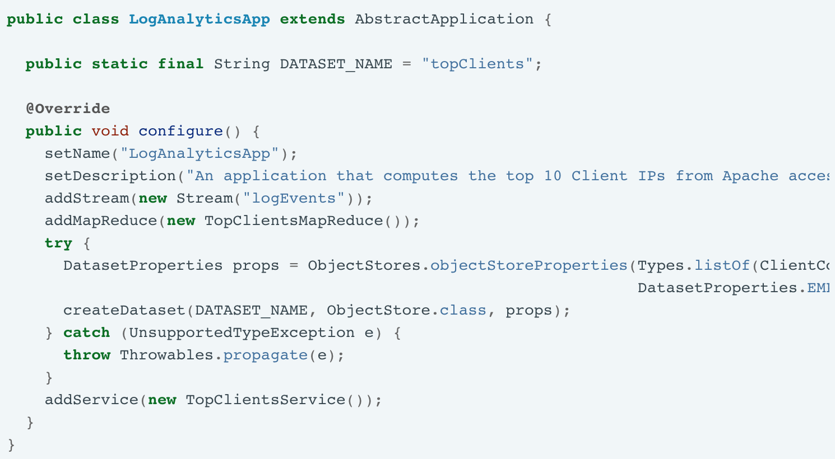
Batch: Application
Notes:
https://docs.cask.co/cdap/5.0.0/en/examples-manual/how-to-guides/cdap-mapreduce-guide.html

Slide 24
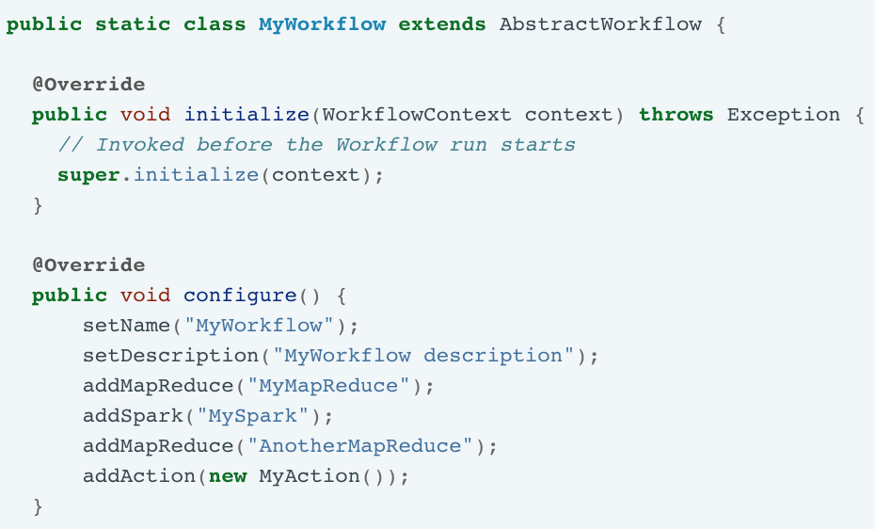
Workflow (1)

Slide 25
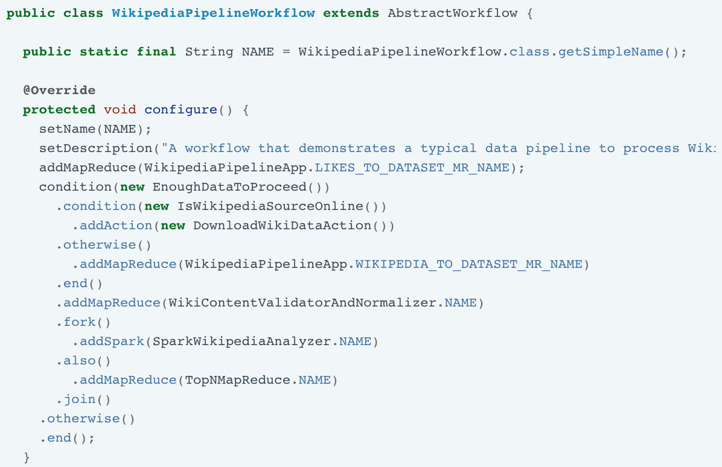
Workflow (2)
Notes:
https://docs.cask.co/cdap/5.0.0-SNAPSHOT/en/examples-manual/examples/wikipedia-data-pipeline.html#examples-wikipedia-data-pipeline
https://docs.cask.co/cdap/5.0.0-SNAPSHOT/en/examples-manual/examples/purchase.html#examples-purchase

Slide 26
CDAP UI Tools
Data Preparation
Data Pipeline

Slide 27
Data Preparation
Transform your data.
Built for applying simple transforms.
Join columns, replace values, drop values conditionally and much more.
Connect to a variety of data sources.
Inspect the data in spreadsheet format.
You can then Operationalize.

Slide 28
Data Prep Concepts
Record
Column
Directive
lowercase <column>
drop isvalid, measurement
…
Step
Pipeline
To Operationalize.
Next Topic.

Slide 29
Namespaces
logical grouping of application, data and its metadata in CDAP.
can be thought of as a partitioning of a CDAP instance.
primary motivation for namespaces is to achieve application and data isolation and allow multi-tenancy.
Namespace benefits:
Support different computing environments, such as dev, QA, and staging;
Support multiple customers
Support multiple sub-organizations within an organization.

Slide 30
Hands-on : Creating Namespace in distributed setup (for multi-sharing)
To start developing pipelines under our own namespace and avoid conflicting with other’s dirs/datasets, follow below steps
Create your workspace in HDFS :
<master-node> hdfs dfs -mkdir /demo
Create your Hbase namespace :
<master-node> hbase shell <hbase> create_namespace ‘demoNS’
Create your DB in Hive :
<master-node> hive <hive> CREATE DATABASE demoDB;
Now, goto CDAP UI and on right upper corner, click on Namespace > Add Namespace Give a name to your namespace. Eg: demo and provide above HDFS, Hive DB and Hbase Namespace details.

Slide 31
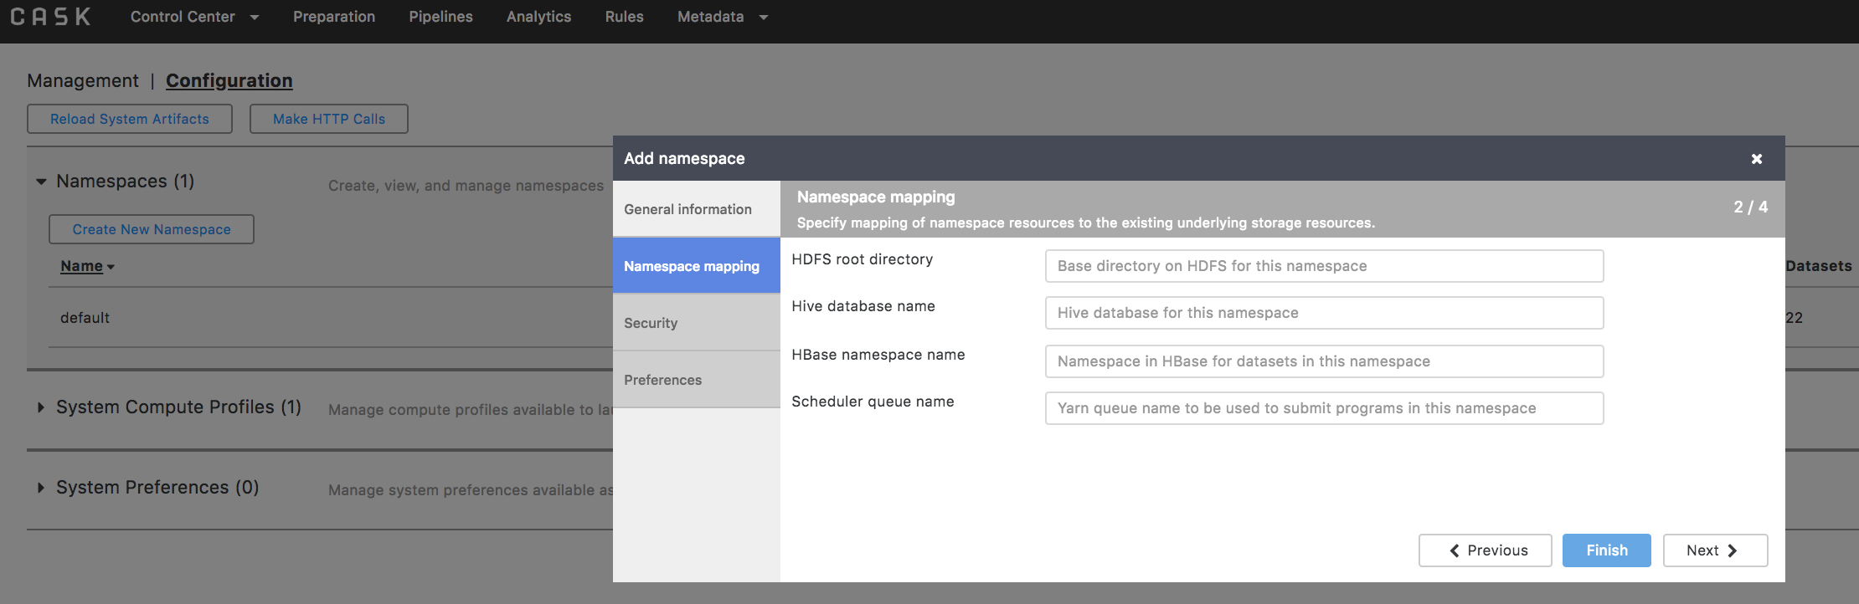
Creating a Namespace

Slide 32
Exercise: Data Preparation
https://docs.cask.co/cdap/5.0.0/en/user-guide/tutorials/index.html
This one is Hands-on Lab.

Slide 33
Data Pipelines
Allows you to ingest, transform, analyse and store data using Spark and MapReduce.
Pipelines are applications—specifically for the processing of data flows—created from artifacts.
Series of Stages like:
Sources
Transforms
Analytics
Actions
Sinks
Error Handling
Logical and Physical
Batch and Realtime
Notes:
An artifact is an "application template". A pipeline application is created by CDAP by using a configuration file that defines the desired application, along with whichever artifacts are specified inside the configuration. Artifacts for creating data pipelines are supplied with CDAP.

Slide 34
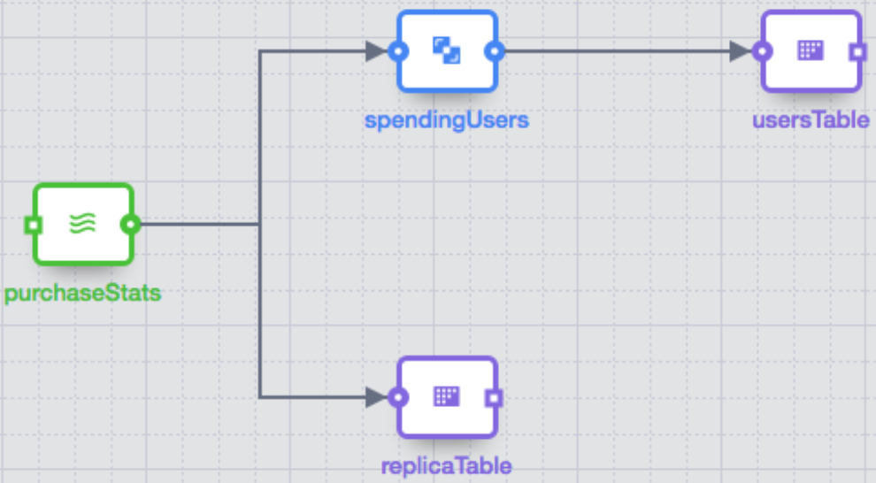
Stages And Plugins
General progression of a Pipeline:
Pre-run operations
Data acquisition
Data transformation
Data publishing
Post-run operations
Different plugins are available to provide functionality for each stage.

Slide 35
Demo: Build A Simple Pipeline

Slide 36
Actions
Actions can be configured for a batch pipeline.
Takes place at start or at completion.
Actions at the end will only run if the pipeline successfully completes.
If you want to run Action irrespective of successful completion, use post-run action.
Notes:
If configured, the action takes place either at the start or at the completion of a pipeline run. All actions configured for the start will complete first before any other stages, and all other stages will complete before any of the actions at the end are run.

Slide 37
Post-Run Action
Post-run action run based on one of the 3 conditions:
Completion
Success
Failure
Some post run actions may be:
Sending an email
Running a database query
Making an HTTP Request

Slide 38
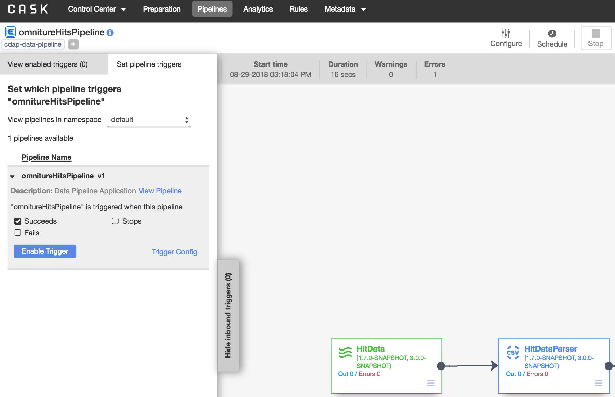
Trigger
Used to chain pipeline execution.

Slide 39
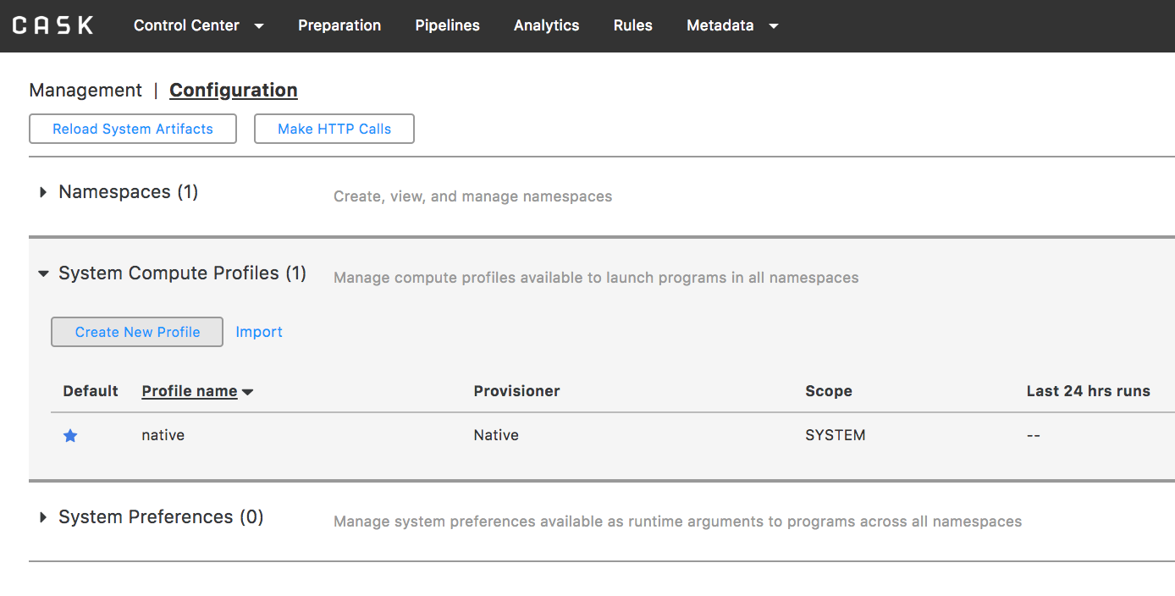
Compute Profile
Allows user to run programs in remote Hadoop/cloud environments.

Slide 40
Preferences
Provide the ability to save configuration information at various levels of the system
CDAP Instance
Namespace
Application
Program
All preferences are collapsed into one.
Precedence of Preferences
CDAP Instance < Namespace < Application < Program < Runtime Arguments
getRuntimeArguments
Notes:
Example: A configuration preference SAMPLE_KEY is set to 20 at the namespace level and is set to 10 at the program level. When the program is started, the value set at the program level overrides the value set at the namespace level and thus the value for the preference SAMPLE_KEY will be 10.

Slide 41
Preferences vs Runtime Arguments
Preferences are persisted across run; Runtime arguments are one-time only.
System Populated runtime arguments
logical.start.time
…
Scoped runtime arguments
mapreduce.oneMapReduce.read.timeout=30
mapreduce.*.read.timeout=30
…

Slide 42
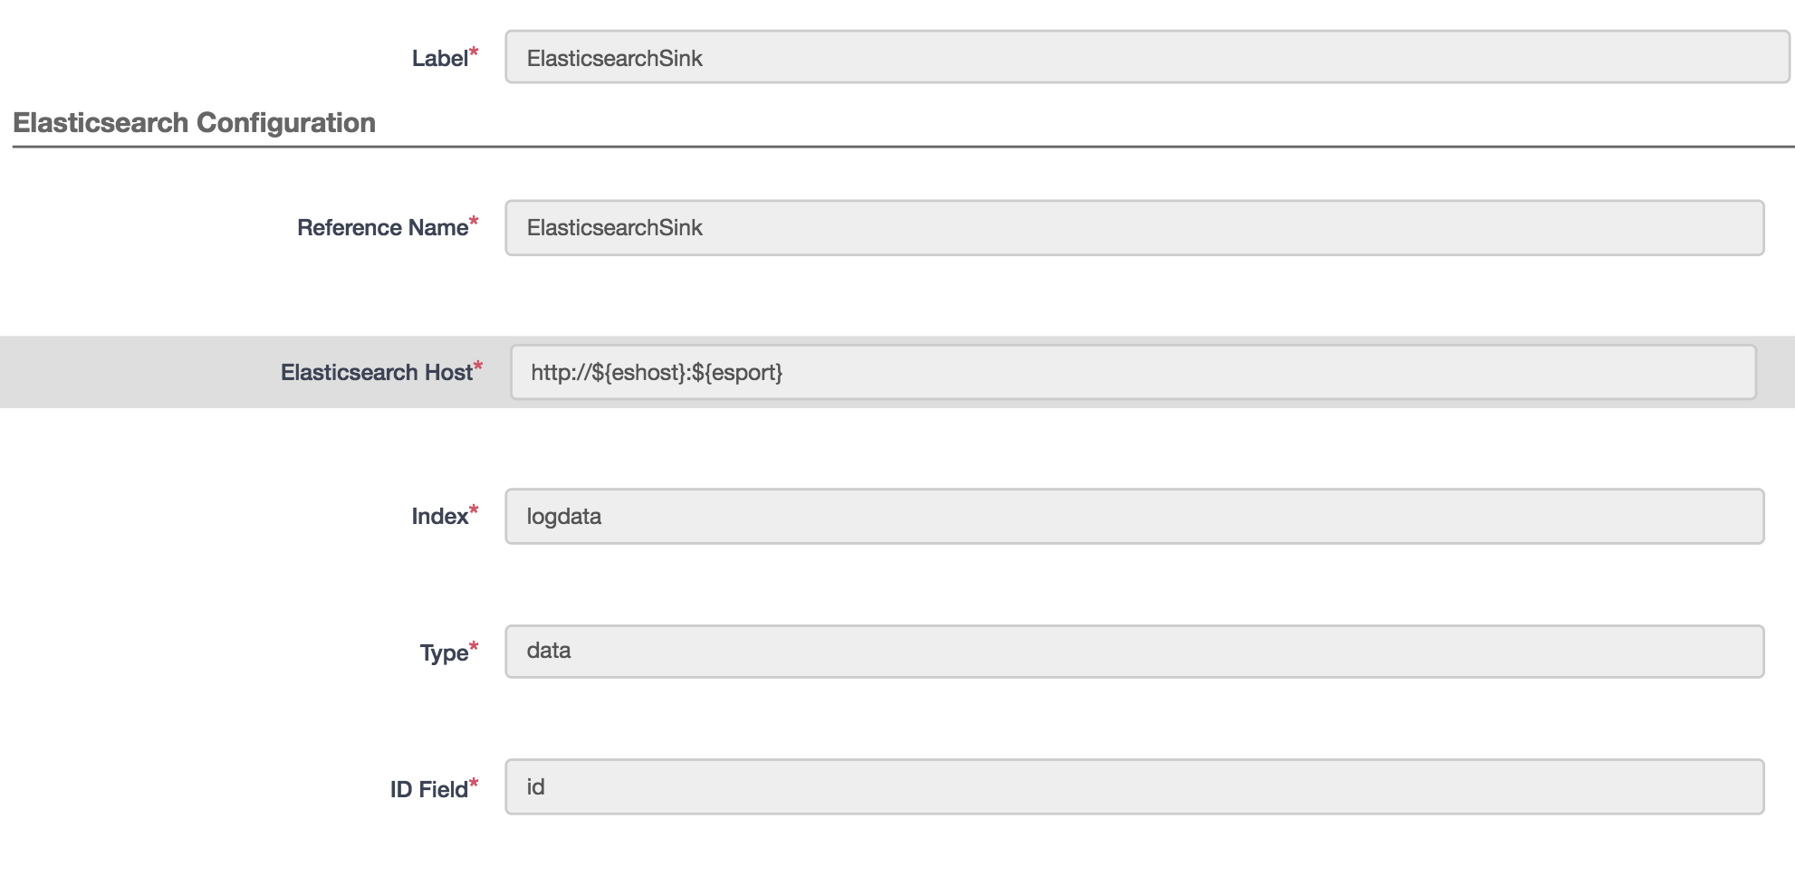
Runtime Arguments

Slide 43
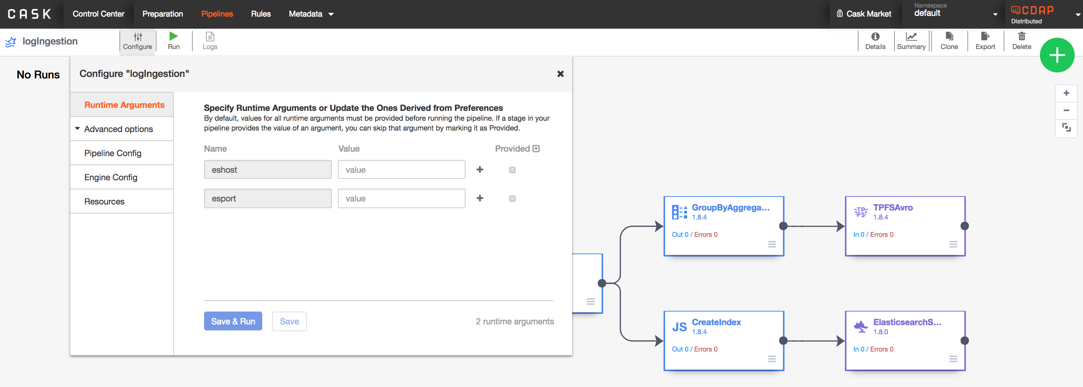
Runtime Arguments

Slide 44
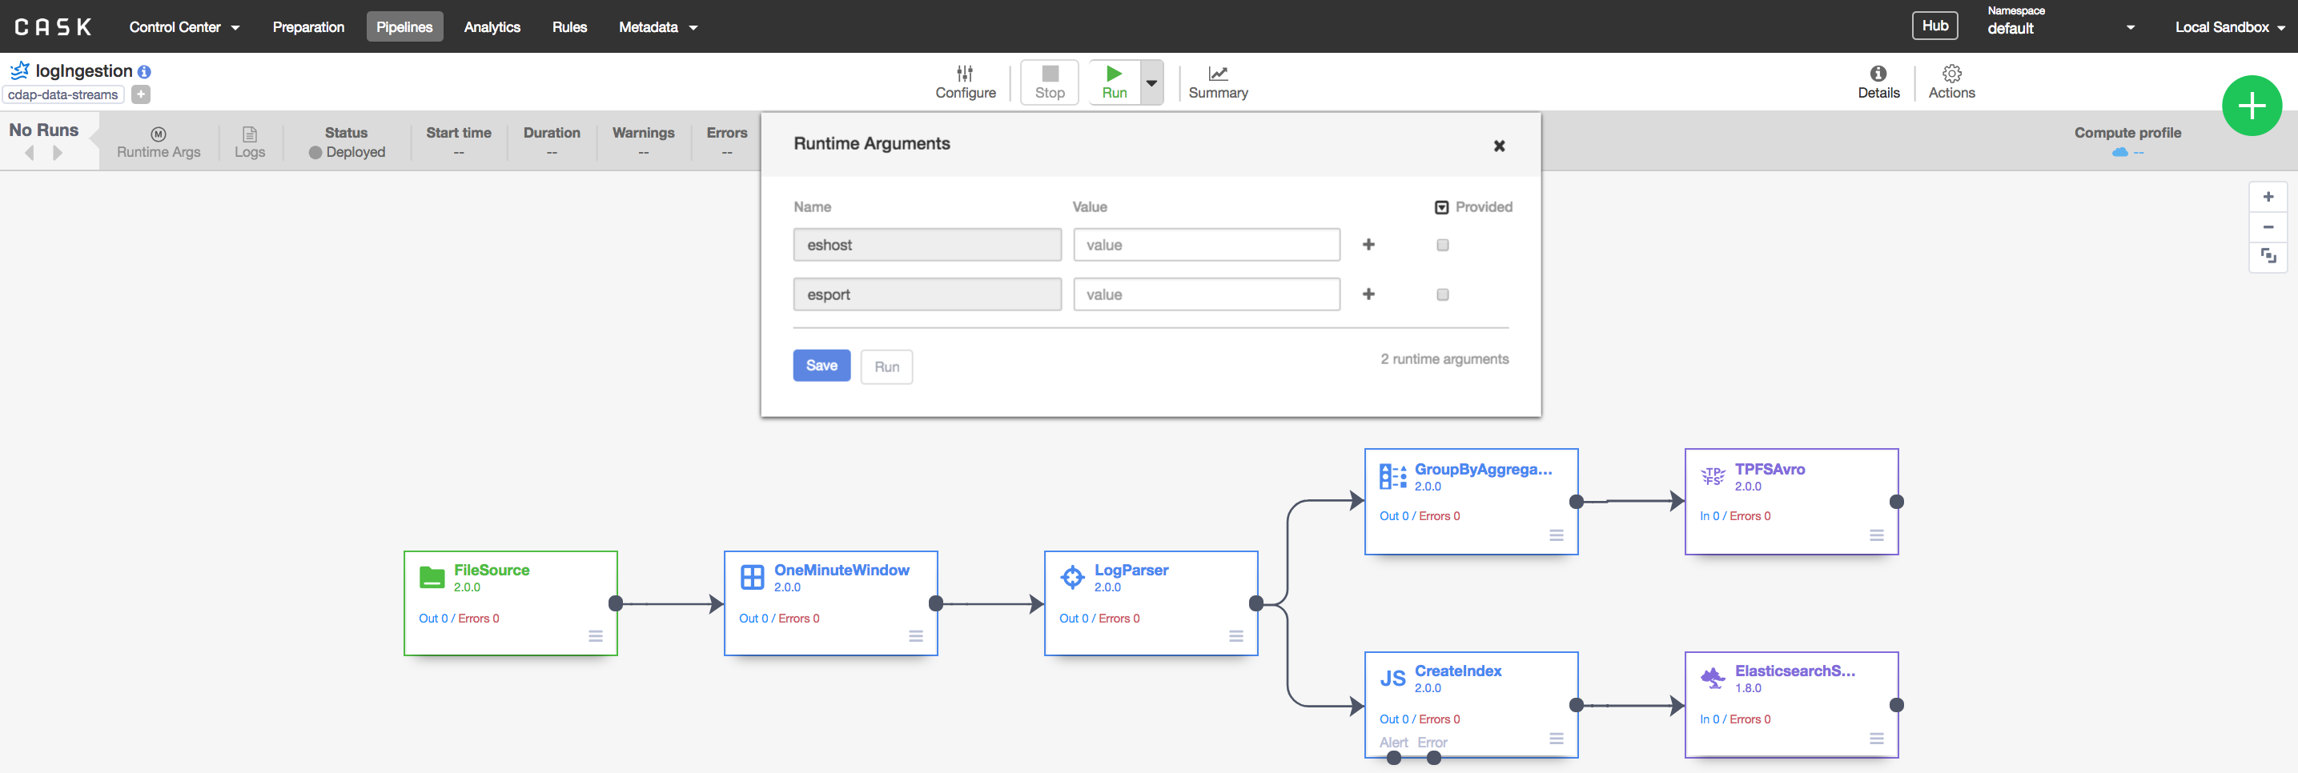
Runtime Arguments

Slide 45
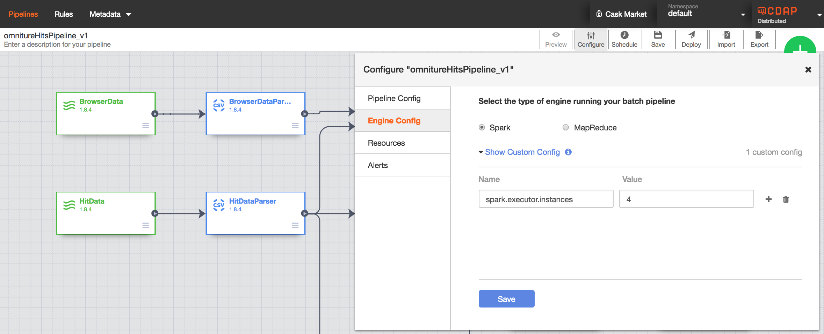
Engine Config
Configurations for the underlying execution engine.

Slide 46
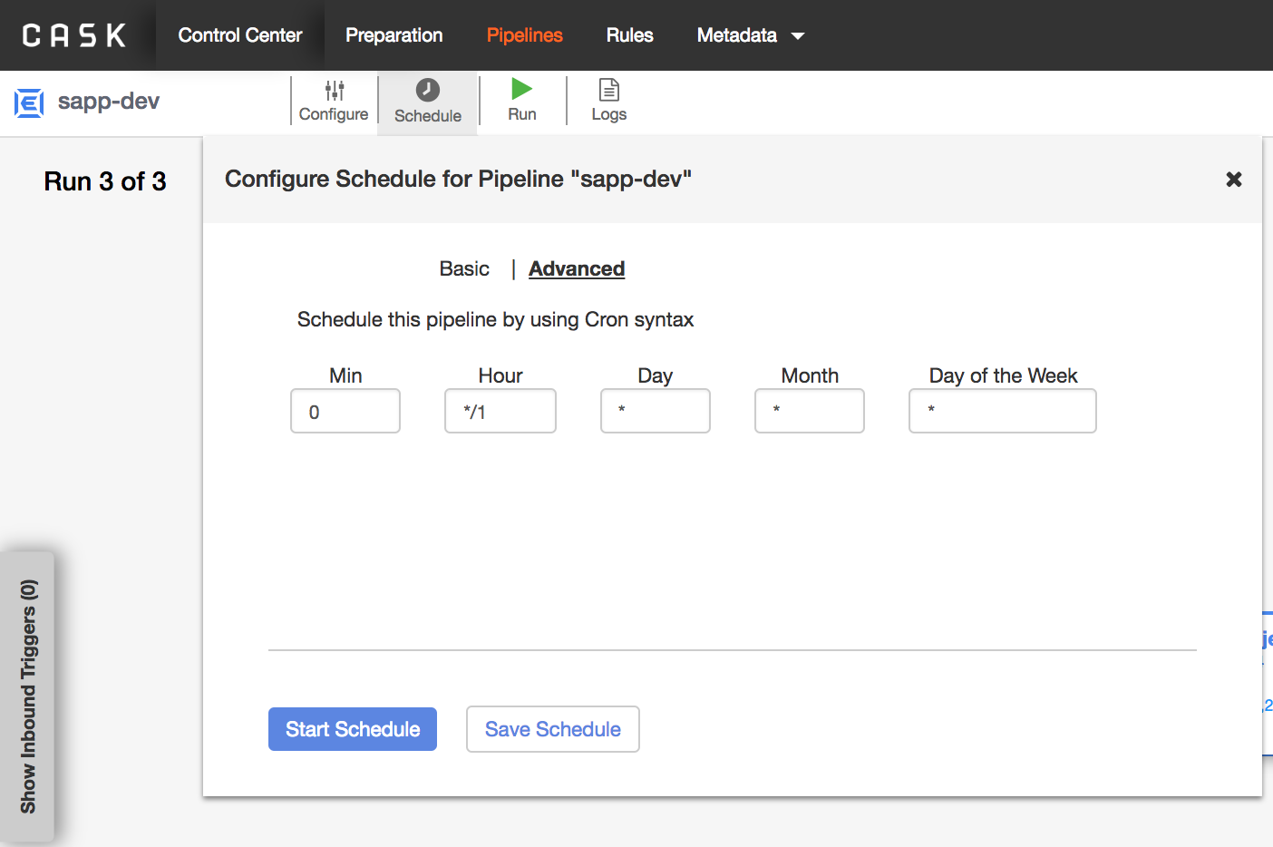
Schedule

Slide 47
Deploy Pipeline

Slide 48
Plugins
Extension to CDAP that provides a specific functionality.
Data Sources
Transforms
Data Sinks
Plugin properties indicates what that plugin is to do.
Available Plugin Reference
You can create Custom Plugins to extend CDAP functionality.
Can be deployed as System or User artifact.
User Artifact: Same namespace.
System Artifact: Across any namespace
Namespace: logical grouping of application, data and its metadata (covered later).

Slide 49
Custom Plugin Development
CDAP provides for the creation of custom plugins to extend the existing cdap-data-pipeline and cdap-data-streams system artifacts.
Plugin Types
Batch Source (batchsource, restricted to batch pipelines)
Batch Sink (batchsink)
Streaming Source (streamingsource, restricted to real-time pipelines)
Transformation (transform)
…
Notes:
Exaustive list https://docs.cask.co/cdap/5.0.0-SNAPSHOT/en/developer-manual/pipelines/developing-plugins/plugin-basics.html

Slide 50
Custom Plugin Development Steps
Maven Archetype
Annotations and Plugin Config
Implement plugin logic
Plugin Presentation
Test
Package
Deploy

Slide 51
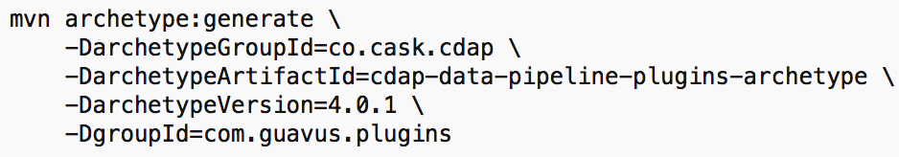
1. Get Started: Maven Archetype
In pom.xml, expose packages for plugins that you want to make accessible in CDAP UI.
Any third-party library that you may be using in your plugin code should also be mentioned.
This is done in tag <_exportcontents> in pom.xml. Eg: <_exportcontents>com.guavus.cdap.plugins.transform.*, org.*</_exportcontents>

Slide 52
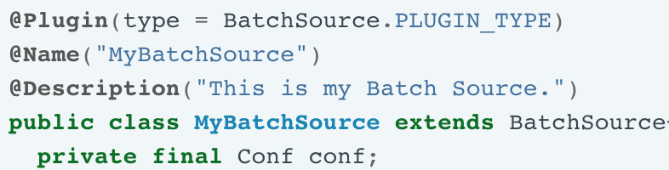
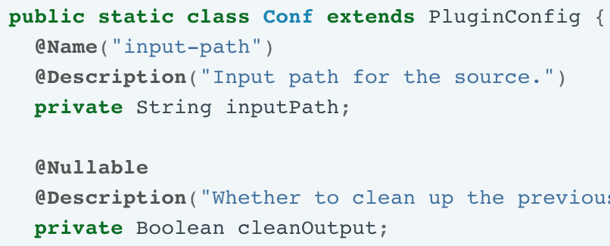
2. Annotations & Plugin Config
Class Annotations
@Plugin
@Name
@Description
Plugin Config
@Name
@Description
@Nullable

Slide 53
3. Implementation
Write the Plugin class by extending the apt PluginType class.
Let’s explore some implementations.

Slide 54
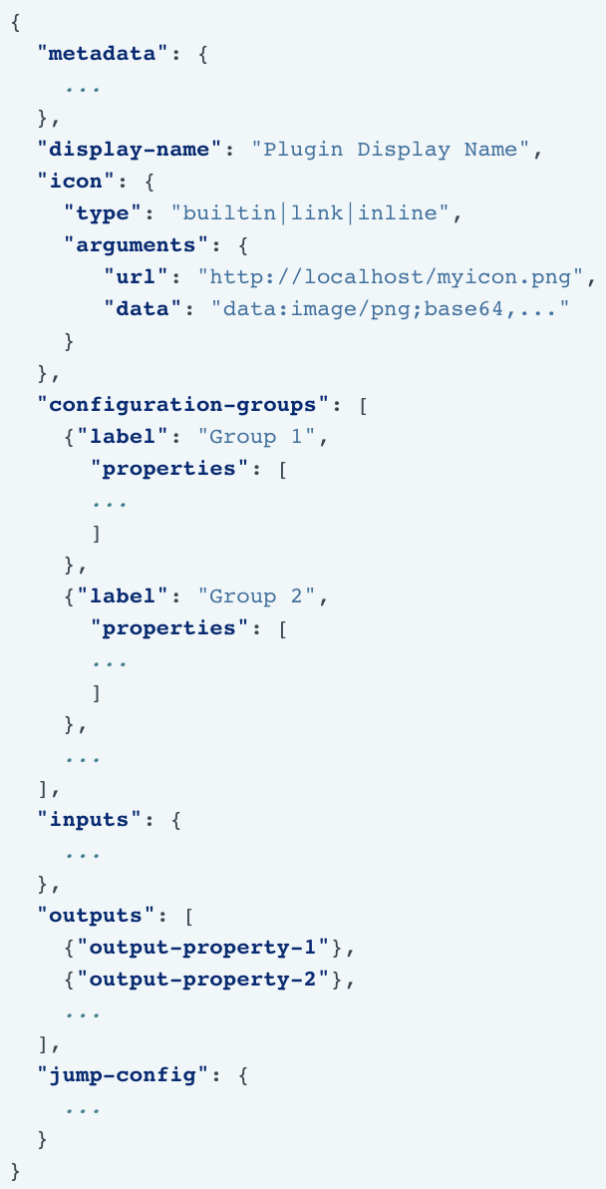
4. Plugin Presentation
When plugin displays in UI, properties are represented by Widgets.
Plugin Widget JSON is required.
Metadata
Configuration Groups
Inputs
Outputs
Stream/ Dataset Jumps
Lets explore a sample.
Notes:
https://docs.cask.co/cdap/5.0.0-SNAPSHOT/en/developer-manual/pipelines/developing-plugins/presentation-plugins.html
https://docs.cask.co/cdap/5.0.0-SNAPSHOT/en/developer-manual/pipelines/developing-plugins/presentation-plugins.html#example-plugin

Slide 55
5. Test Framework for Plugins
Explore a Sample Test Class.

Slide 56
6. Plugin Packaging
To package, present, and deploy your plugin:
Plugin Packaging: packaging in a JAR
Plugin Presentation: controlling how your plugin appears in the CDAP Studio (JSON)

Slide 57
7. Plugin Deployment
You can deploy plugin through:
CDAP UI
CLI
load artifact <target/guavus-transform-plugins-<version>.jar config-file <target/guavus-transform-plugins-<version>.json>
REST

Slide 58
CDAP Test Framework
Testing Spark Applications
Lets explore
https://github.com/pergrand/cdap/blob/master/cdap-examples/SparkPageRank/src/test/java/co/cask/cdap/examples/sparkpagerank/SparkPageRankAppTest.java
Notes:
https://docs.cask.co/cdap/4.0.1/en/developers-manual/testing/testing.html

Slide 59
Debugging
cdap sandbox start --enable-debug
Default port is 5005
Deploy the Application.
Open the Application in IDE and connect to the remote debugger.
Debugging with eclipse
https://docs.cask.co/cdap/4.0.1/en/developers-manual/testing/debugging.html#debugging-with-eclipse

Slide 60
Logging

Slide 61
Logs and Metrics
CDAP collects logs and metrics
Internal services
User applications
Helps in debugging and performance
Accessible through RESTfull API and java clients
Log Location
Standalone: <CDAP-SDK-HOME>/logs
Distributed: /var/log/cdap

Slide 62
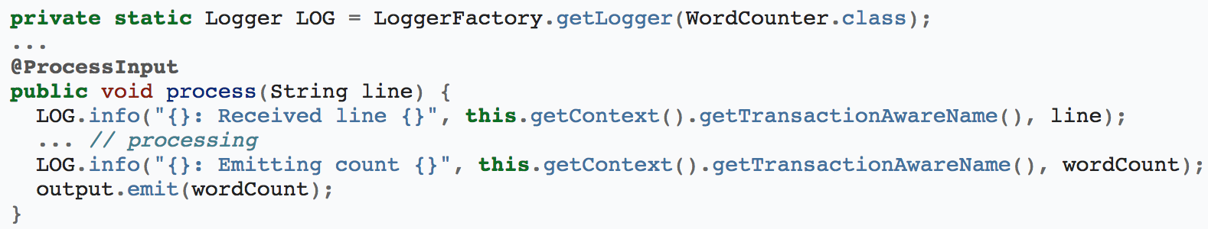
Logging
CDAP supports logging through SLF4J.
Log messages of an application can be viewed in the CDAP UI by clicking the Logs tab of an application.

Slide 63
Metrics
CDAP collects metrics about the application’s behaviour and performance.
How many events processed
How many operations performed etc
User-defined Metrics
Count
Increments (or decrements) the metric
Guage
Sets the metric to a specific value
Use Metrics Explorer

Slide 64
Metadata and Lineage
provides full visibility into the impact of changes while providing an audit trail of access to datasets by programs and applications.
It gives a clear view when identifying trusted data sources and enables the ability to track the trail of sensitive data.
Demo

Slide 65
Other Concepts
Import/Export Pipelines
Logical vs Physical View
Local vs Distributed

Slide 66
Guavus Custom CDAP Plugins

Slide 67
Guavus CDAP Plugins: List
https://github.com/Guavus/cdap-plugins/tree/release/5.4.7

Slide 68
Guavus KafkaSource
Allows you to read data from kafka topic using Hortonworks Schema Registry.
Extends the functionality of CDAP KafkaConsumer plugin.

Slide 70
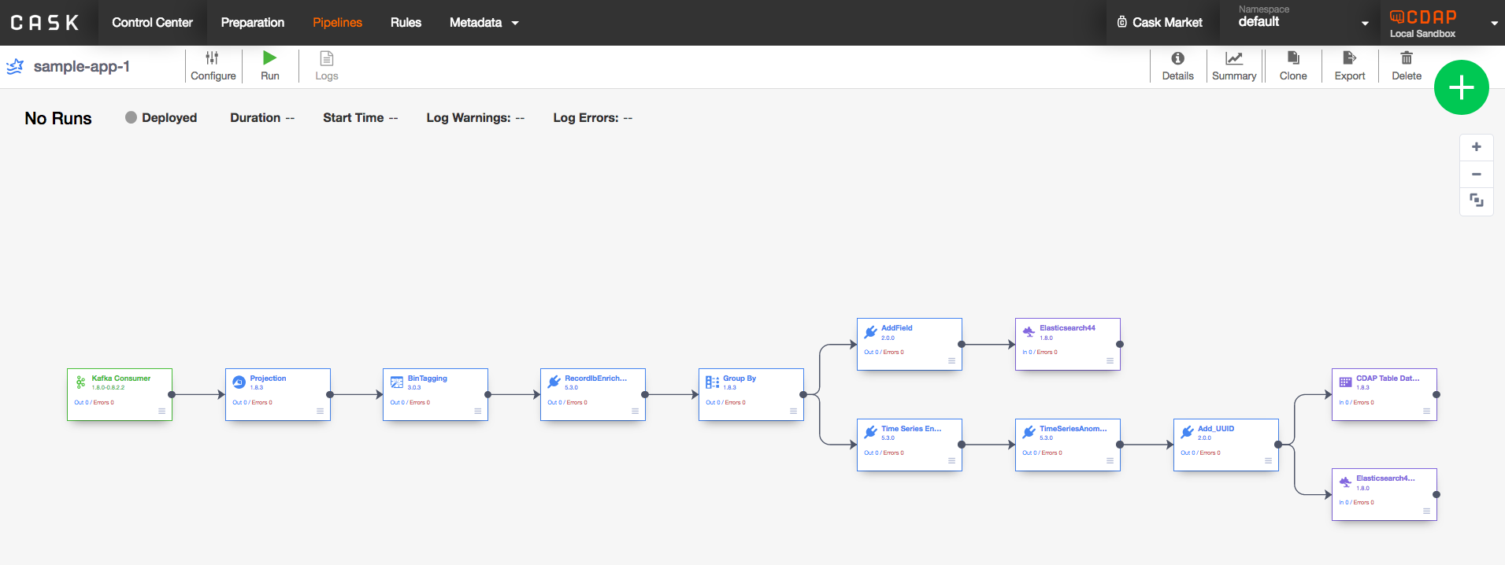
Sample-App Flow

Slide 71
SampleApp: Processing(1)
CDAP will read from Kafka and use the same schema we used earlier while writing.
Use the Projection transformation will be used to rename the temp_air column to “temperature” and change the datatype of union to double.
Use the Wrangler transformation to set the timestamp column to hour boundary for binning.
Use the Guavus RecordEnricher plugin to enrich the records with the “description” column using airport_codes.csv.
Use Guavus IB Management Framework
Use GroupByAggregate to group the data by timestamp, airport_code and airport_description. Calculate Avg of temperature and Max of delay_secs.

Slide 72
SampleApp: Processing(2)
6. Use Guavus TimeSeriesEnrichment plugin for using the Guavus TimeSeriesAnomaly plugin later.
7. Use AddField plugin to add a field to the output dataset to write to ElasticSearch.
You may use other dataset as needed.
8. Serve the results from ElasticSearch.

Slide 73
Step 1: Processing
Install the Guavus KafkaSource plugin.
Use the KafkaSource plugin to read from Kafka.
In the OutputSchema section, use import to use the avsc file.

Slide 74
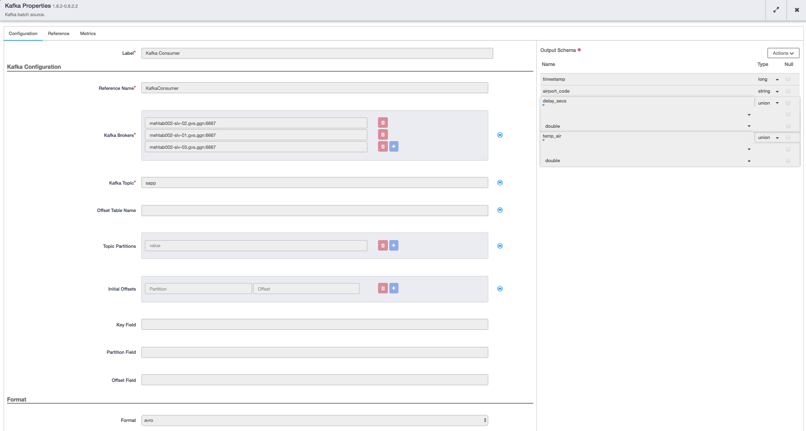
Step 1: Processing

Slide 75
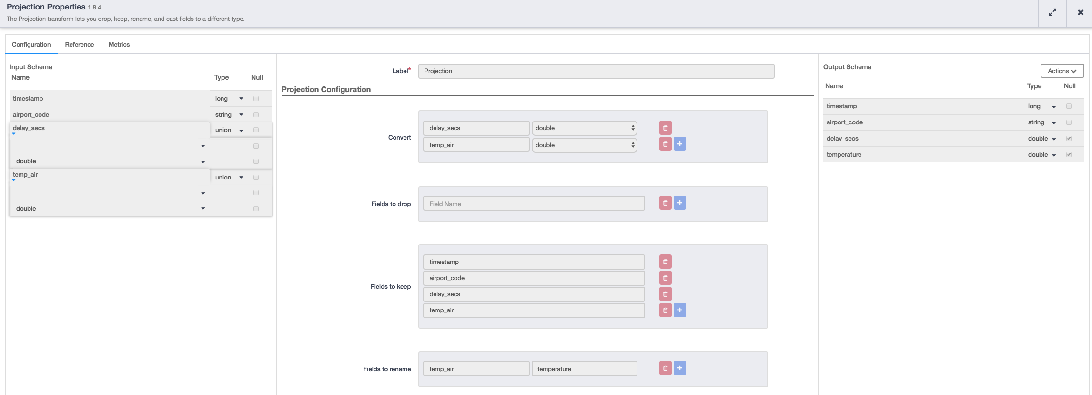
Step 2: Projection plugin

Slide 76
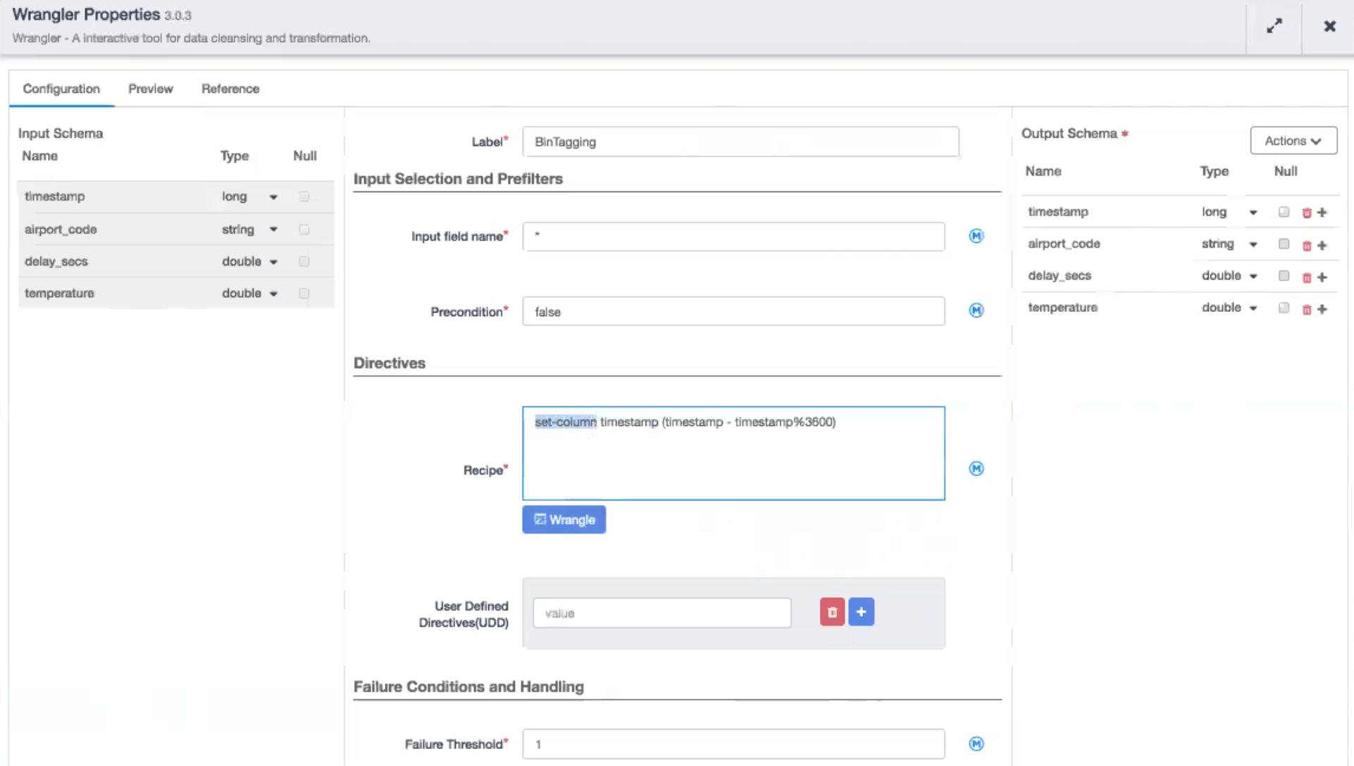
Step 3: Wrangler Plugin

Slide 77
Step 4: Guavus Record Enricher Plugin

Slide 78
IB Framework
Information Base
Examples
Supports data ingestion from various sources
Allows for generating, editing and publishing IB’s
Supports version management
Provides Edits support
Allows easy and fast customization

Slide 79
Installing EditService(IB Framework) and Publishing IB
Run the playbook
Verify installation
Create IB
Edit IB
Publish API’s

Slide 80
1. Run Playbook
ansible-playbook -i inventory/generated/<env-type>/<inventory-name>/hosts playbooks/ibmanagement-hdp/main.yml --ask-pass
Ibmanagement container is deployed on master nodes
Logs to Kibana using EFK
The EditService port is 9180
HAProxy for HA
Kibana Port is 5601

Slide 81
2. Verify Installation
HAProxy UI
Kibana UI (EFK stack)

Slide 82
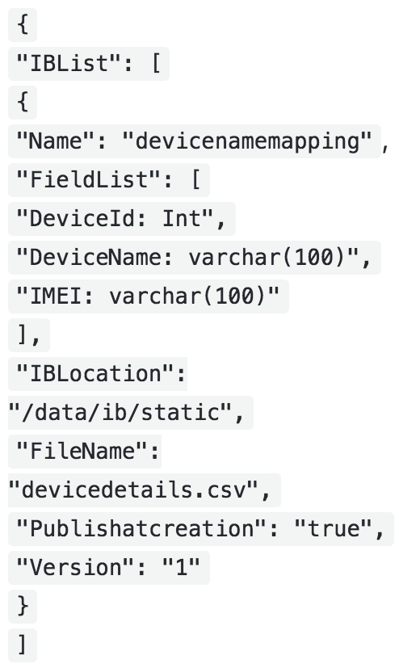
3. Create New IB
http://${IP}:${PORT}/editservice/createib
POST method
<<Binary IB>>

Slide 83
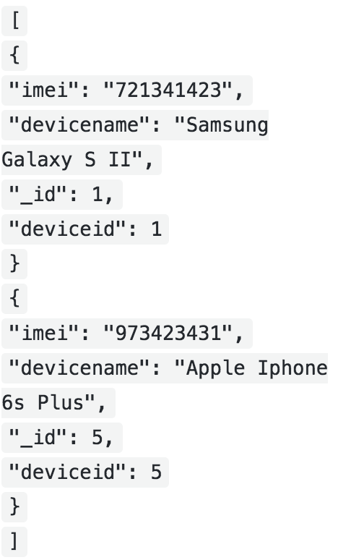
4. Edit IB (for a specific version)
http://${IP}:${PORT}/editservice/ib/{type}/{version}
PUT
Example:
http://192.168.169.210:9080/editservice/ib/devicemanagement/1
Notes:
https://github.com/Guavus/cc-ib-management

Slide 84
IB Publishing
Publish IBs in Hive with IB names and version number.
IB Publishing
IBProvider
IBChangeNotifier

Slide 85
5. Publish API’s
Publish an IB
http://${IP}:${PORT}/editservice/publishBinaryIB | POST
Fetch HDFS path for IB
http://${IP}:${PORT}/editservice/fetchPathForIB?ibName=${ibName}

Slide 86
Useful References
Data Pipelines : https://docs.cask.co/cdap/current/en/user-guide/pipelines/index.html
Existing Plugin Reference : https://docs.cask.co/cdap/current/en/user-guide/pipelines/plugins/index.html
Data Preparation In CDAP : https://docs.cask.co/cdap/current/en/user-guide/data-preparation/index.html
Developing/Writing Plugins : https://docs.cask.co/cdap/4.3.3/en/developer-manual/pipelines/developing-plugins/creating-a-plugin.html
Tutorials : https://docs.cask.co/cdap/current/en/user-guide/tutorials/index.html
More examples : https://docs.cask.co/cdap/current/en/examples-manual/index.html
Rest APIs : https://docs.cask.co/cdap/current/en/reference-manual/http-restful-api/index.html
CLI References : https://docs.cask.co/cdap/current/en/reference-manual/cli-api.html
Java Client APIs : https://docs.cask.co/cdap/current/en/reference-manual/java-client-api.html
Complete JavaDocs for Application APIs : https://docs.cask.co/cdap/current/en/reference-manual/javadocs/index.html
CDAP wiki : https://wiki.cask.co/display/CE/Conditional+Execution+in+Pipelines

